Slide 1
EHS PTSA Membership Meeting
September 20, 2023
Notes:
Laura-call to order
Laura-welcome
Julie says Hi, thank you to board members, if you are here, raise your hand

Slide 2
Formalities & Approvals
Minutes and Correspondence
Financial Report
June
July
August
Mission Statement and Goals (approve)
Standing Rules (approve)
2022-23 End of Year Financial Review
Notes:
Minutes-Candice
Financials-Leanne
Mission-Julie
Standing-Laura
Financial Review-Julie as committee member

Slide 3
2023-2024 budget
Budget Changes for Consideration (budget worksheet)
E-Prep: Increase budget to $2400 (approximately $1 per student)
Reflections: Increase budget to $200
Reallocate unused YES funds (fully-funded by LWSD at this time):
$2000 Teacher training "Lunch N Learn" program
$1750 to Grants line item
Add Senior Breakfast line item for $350
Increase LWSD Council Scholarship Donation to $225 (apply funds from Scholarship Basket line item to Scholarship Donation line item
Motion to approve 2023-2024 Budget
Notes:
Leanne/Laura/Julie to cover budget changes

Slide 4
Now. More Than Ever.
Each year, the EHS PTSA’s Pass the Hat fundraiser provides thousands of dollars in grants to Eastlake to enrich student experiences and learning. These grants support Eastlake and its school administration, staff, and student organizations with items for which they might not otherwise have funding.
Over the past few years these grants have helped support almost every learning department including: Humanities, Science, Music, Business, Transition Room, and the Library.
When choosing the grant recipients, the EHS PTSA ensures that funds reach as many students as possible and that they have lasting benefits for years to come.

Slide 5
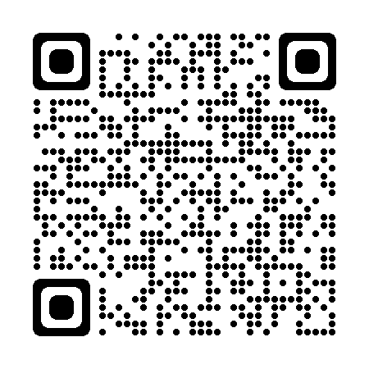
Now. More Than Ever.
Please join us by becoming a member today! http://join.ehsptsa.org/

Slide 6
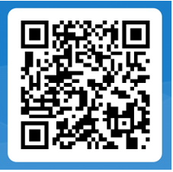
Decisions and plans
Holiday Bazaar: 30th Anniversary!
This year on November 4th, 2023
Open Volunteer Positions here:
Grants
Senior Events
Holiday Bazaar Volunteer Sign-Up

Slide 7
Mr. Todd Apple EHS Principal
WOLF CHAT

Slide 8
Thank you!
Next Membership Meeting—January 17th, 2024 at 6:00 PM (via Zoom)

